Slide 1
School to Work
First Day

Slide 2
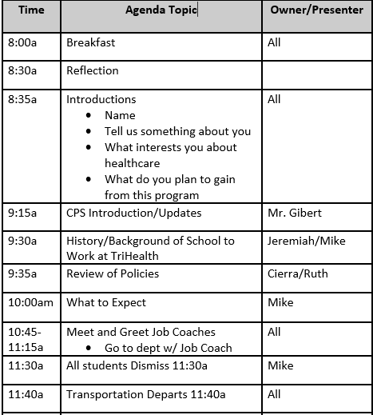
Agenda

Slide 3
Reflection
“The longer I live, the more I realize the impact of attitude on life.
Attitude, to me, is more important than facts. It is more important than the past, than education, than money, than circumstances, than failures, than successes, than what other people think, say or do. It is more important than appearance, giftedness or skill. It will make or break a company…a church…a home. The remarkable thing is we have a choice every day regarding the attitude we embrace for that day. We cannot change our past…we cannot change the fact that people will act in a certain way. We cannot change the inevitable. The only thing we can do is play the one string we have, and that is our attitude…”

Slide 4
Introductions
Name
Share something about yourself
What are you hoping to learn in this program
What interests you about healthcare
Any extra-circulars
What is a hobby you have

Slide 5
History & Background of the Program
https://www.youtube.com/watch?v=NcZJ1nUSPGE
https://www.youtube.com/watch?v=yTRAX5MOWos
https://www.rochesterregional.org/medical-education/training-programs/youth-apprentice-program/student-experiences
https://local12.com/health/transforming-health/partnership-between-local-schools-organizations-helps-students-get-jobs-in-health-care?jwsource=cl

Slide 6
Break

Slide 7
Review of Policies

Slide 8
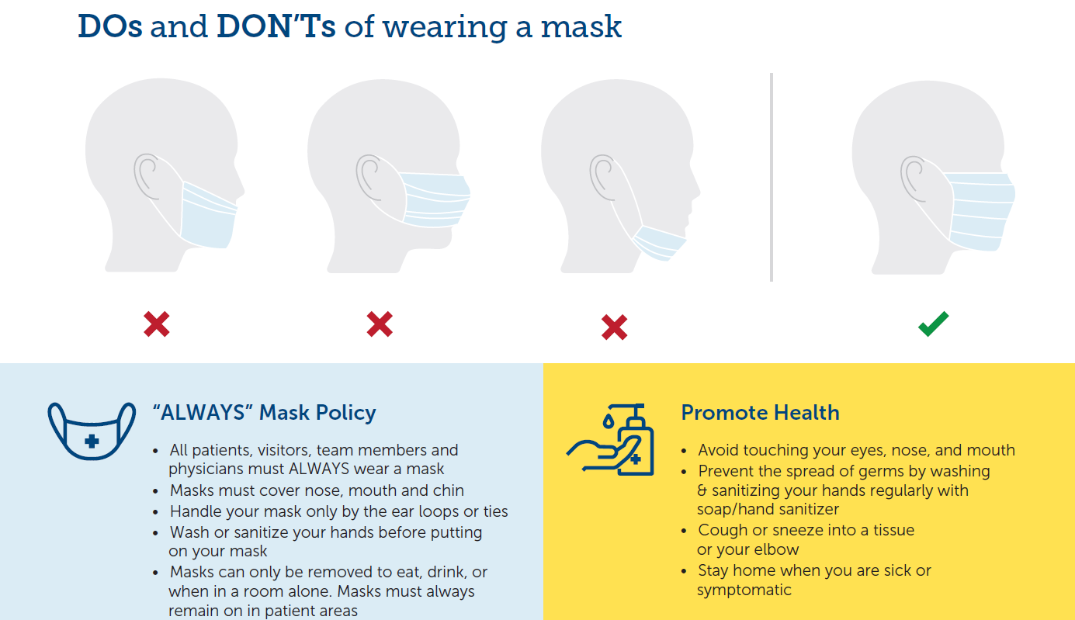
COVID-19

Slide 9
Time and Attendance
Daily Attendance & Participation:
40% of quarter grade
Each work day is considered an assignment out of 2 and is based on the following criteria:
1 Point – arriving to work on time (clocked in at assigned department on-time)
1 Point – clocking out on time/staying within approved shift time

Slide 10
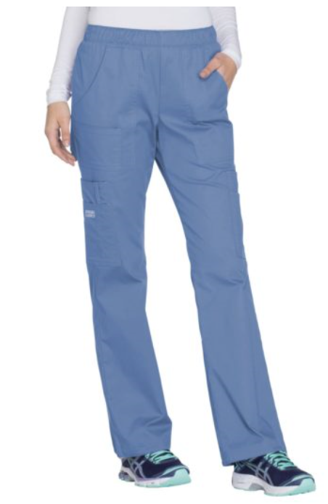
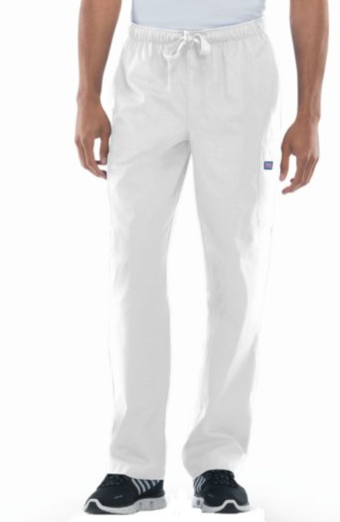
Uniform & Appearance

Slide 11
Attitude
Have a positive attitude
Maintain positive body language
Have good verbal & non-verbal skills
Treat these two years as interview
Always say “hello” and don’t take it personal if they do not respond
Say good things about your team members/ classmates
Walk away from gossip
Review “Always” Impressions: AIDET + Promise & HEARD

Slide 12
AIDET + the Promise

Slide 13
HEARD

Slide 14
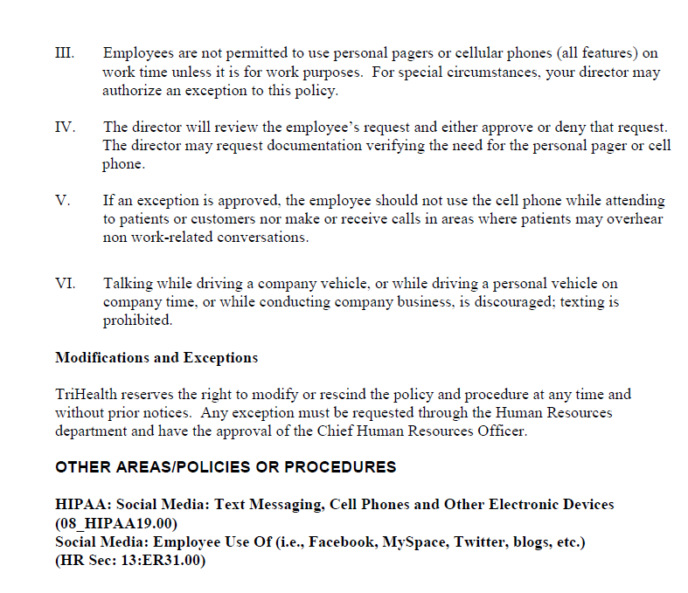
Cellphone Policy

Slide 15
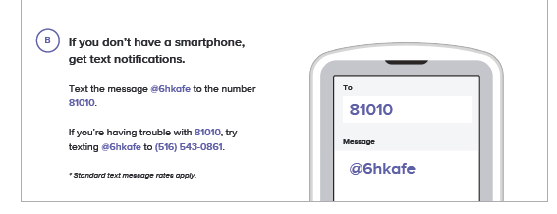
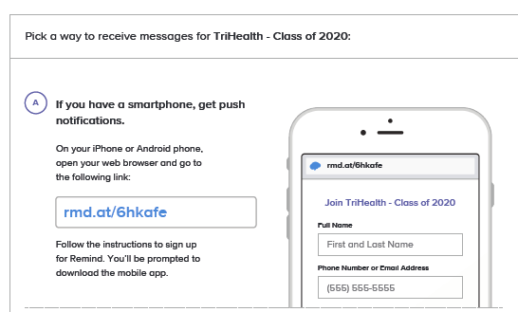
Communication

Slide 16
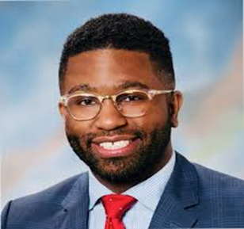
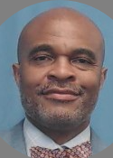
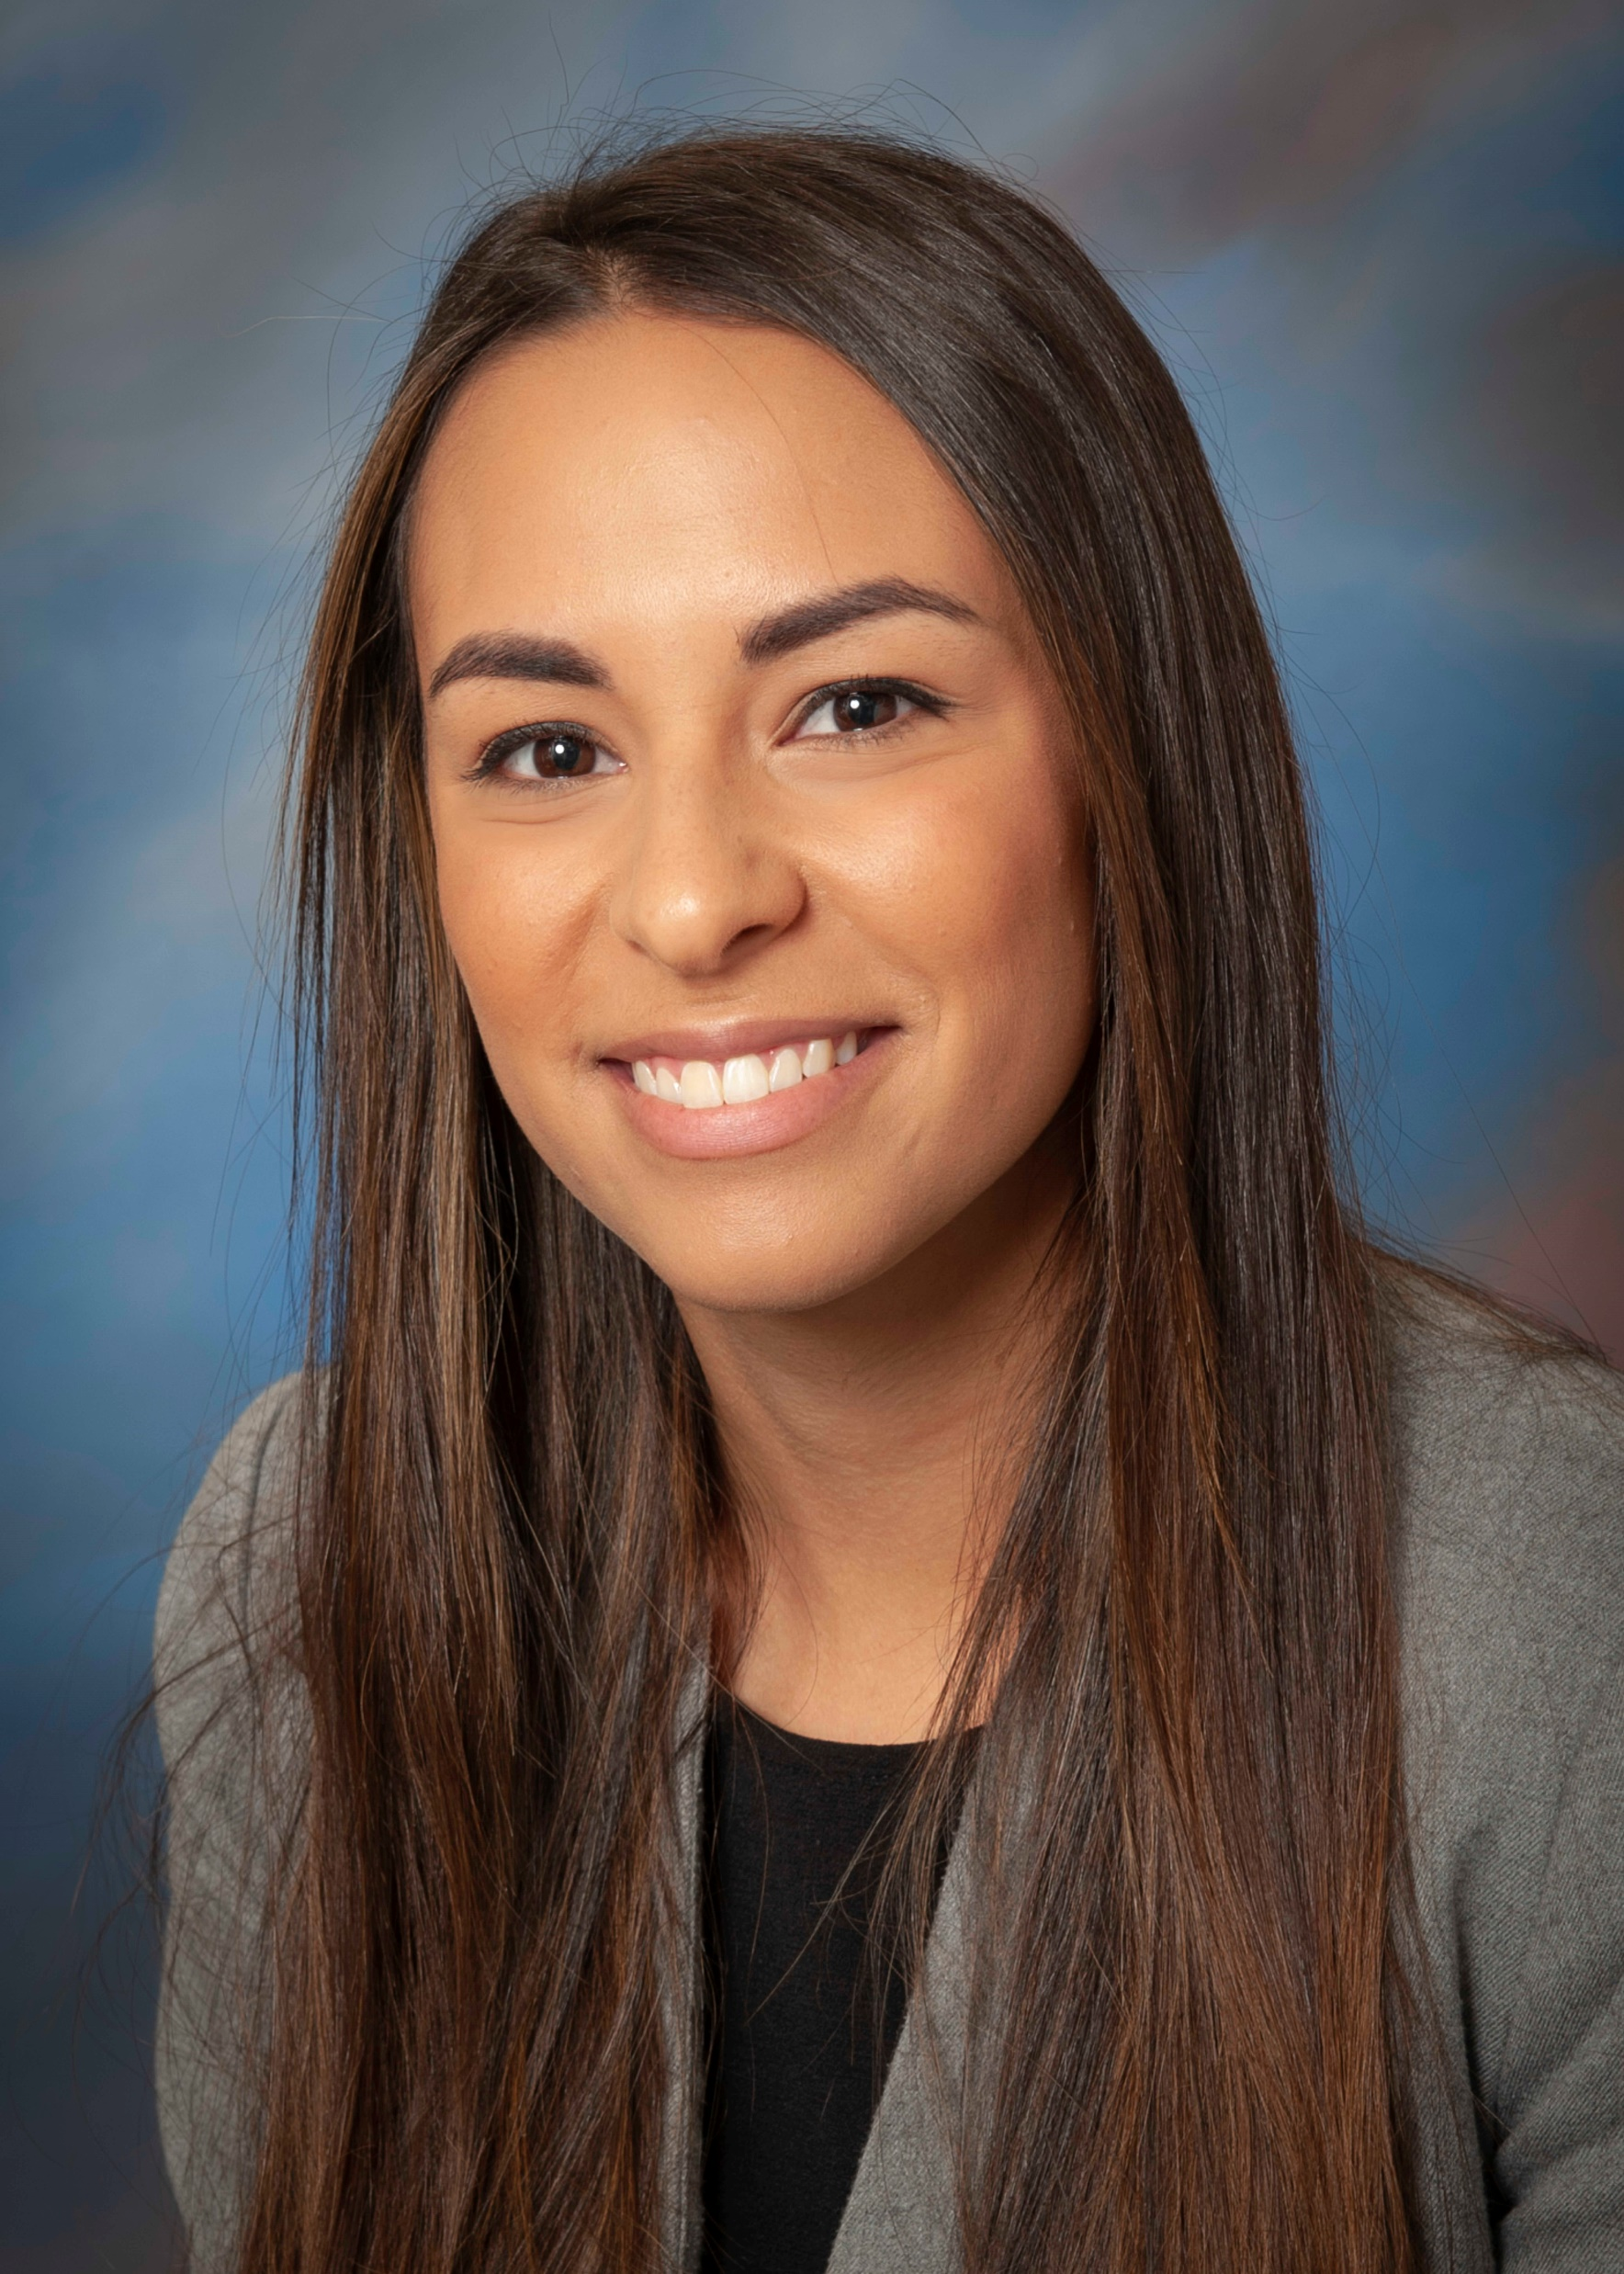
TriHealth Leadership
Jeremiah Kirkland
Executive Director
Jeremiah_Kirkland@trihealth.com
(513) 808-0773
Mike Jones
Manager
School-To-Work Apprenticeship Program
Michael_Jones@trihealth.com
(513) 291-5526
Cierra Mitchell
Project Manager
Cierra_Mitchell@trihealth.com
(513) 519-2358

Slide 17
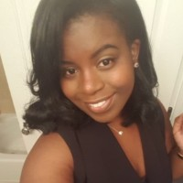
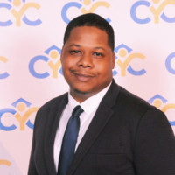
Cincinnati Public School Leadership
Brittney Cousins
Career-based Learning Manager
cousinb@cpsboe.k12.oh.us
(513) 417-3165
Nathan Lane
Hughes STEM Teacher
lanenat@cpsboe.k12.oh.us
(513) 443-4533
Philip Gibert
Employment Specialist
gibertp@cpsboe.k12.oh.us
(513) 386-4254

Slide 18
Where to go with questions
Lost badge –Connect with Mr. Mike or go to security of Level 5 of Clifton lobby ( reprint badges )
Paycheck discrepancy – check with Mr. Mike first
If a paycheck was not deposited into your account, you need to set up direct deposit. (Direct Deposit is mandatory)Inform Mr. Mike and or call Payroll 569-6474
Hours 730a-4pm Mon-Fri
Forget logon or Employee ID- Mr. Mike
Forget password, reset password call I.S. 569-5100
ATM- 1st Fl Lobby
GECU on-site 1st Fl Lobby 7am-430pm Mon-Fri Closed 1pm-2pm lunch

Slide 19
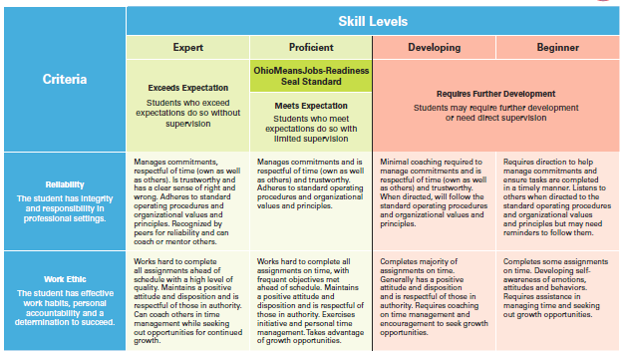
Student Ohio means jobs readiness seal rubric

Slide 20
GE Credit Union Application
If you are opening a GECU account, please complete PDF form and email back to Catlin Bramforth as stated in email. If you have any questions, concerns, or need assistance please let us know during the afternoon session.

Slide 21
Rotations
School to Work program department rotations:
Labor & Delivery
Rehab Services
Rehab Admin
Pharmacy (inpatient)
Patient transportation
Logistics/Inventory
Logistics/Supplies basement
Perioperative Services
Wound Care (8th Fl)
Good Samaritan College Nursing
Food & Nutrition
Guest Services
AV Media Services
Telemetry/Vascular
Environmental Services

Slide 22
Questions

Slide 23
Meet and Greet Job Coaches

Slide 24
Lunch

Slide 25
Headshots and Ice Breakers

